Slide 1

Engineering Education With Extended Reality (XR)
Technical Deep Dive Presentation
Professor Aveek Dutta, Department of Electrical & Computer Engineering
Joren Cruz, Diego Tapia, Daniel Wang

Slide 2
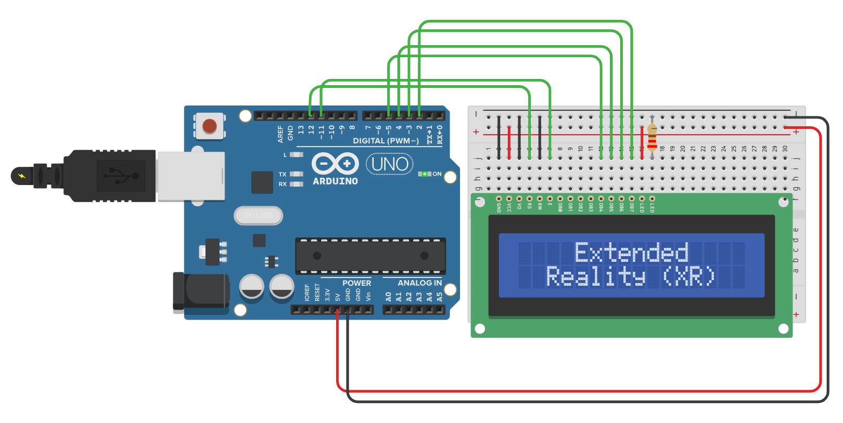
Introduction
Objective
Importance
Electronics Lab Simulator in Extended Reality​
Educational Tool for Learning Basic Circuits
Notes:
Briefly state the objective of this presentation​
The objective of this capstone project is to build an electronics lab simulator in extended reality​
Like the ECE labs, there will be guided lessons and challenges for you to follow and complete​
Briefly state the importance of the topic or why it should matter to the audience​
XR Lab brings an immersive and experiential domain of learning/education to students, teachers, and "hobbyists" (anyone with a curiosity for electronics)

Slide 3
AGENDA
Background & Context​
Problem Statement​
Methodology​
Key System Requirements​
System Demonstration​
Logical Design​
Physical Design​
Limitations​
Recommendations for Future Work​
Conclusions​
Individual Contributions​
Questions
Notes:
Quick overview of the key points you will cover​

Slide 4
Background & Context
Background:
COVID-era of teaching showed the hardships of remote education
Context:
We’re equipped with the open-source software; Let’s put it all together in one place, an immersive environment.
Notes:
Clearly define the problem or challenge you are addressing​
Tasks for this project include developing initial requirement analysis and hardware/software requirements to build these applications.​
It will involve using some AR/VR equipment and AR/VR development suite for iPhone/android​

Slide 5
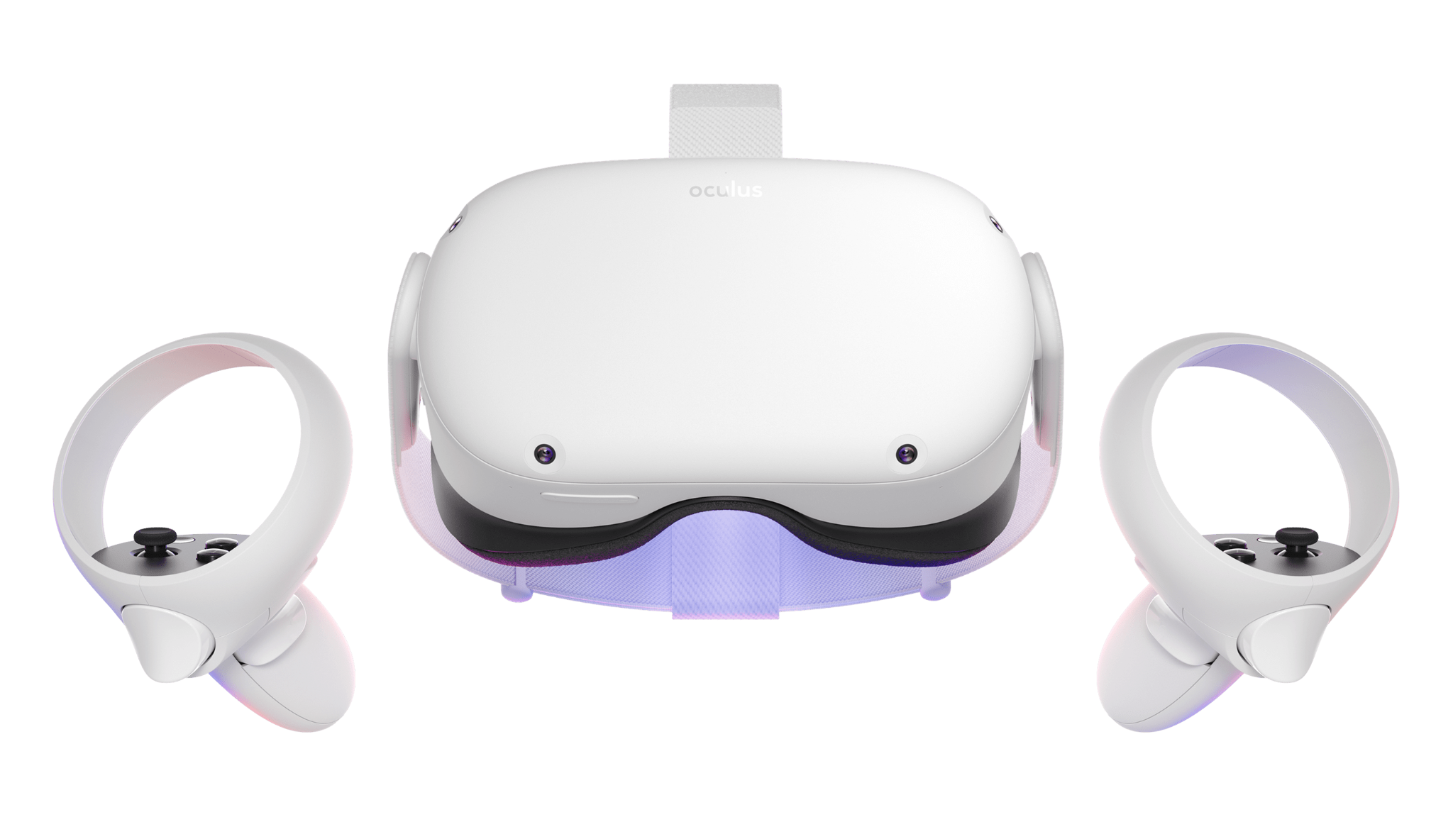
Problem Statement
Task: Developing the Initial Analysis Applications That Fit the Hardware/Software Requirements
Notes:
Design Concept: Explain the overall concept of your logical design. This might​
include abstract representations, flowcharts, or diagrams.​
Components: Outline the main components or elements of your design.​
Relationships: Describe the relationships between these components. How do they​
interact with each other? What functions do they serve?​
Advantages: Explain the advantages of this design. Why is this the best solution for​
your problem or project?​
Considerations or Constraints: Discuss any constraints or considerations that​
impacted your design. These could be things like cost, time, or technological​
limitations.​
​
Note: Use visuals whenever possible. Design is often best explained with​
diagrams or other visual aids. Visuals can make it easier for your audience to​
grasp the concept and see how all the components fit together.​

Slide 6
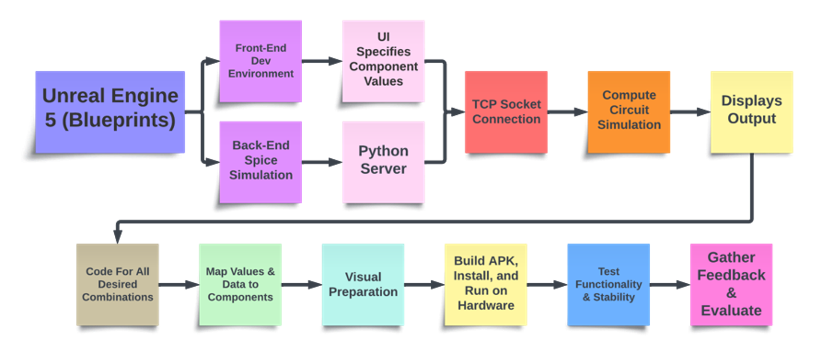
Methodology
Notes:
Your approach to the problem​
Engineering design process(es) utilized​
Any tools, techniques, or methodologies you have used​
Break down the process into manageable parts if necessary

Slide 7
Key System Requirements
Functional Requirements
Interaction : Controller Inputs
Information : Client Server Communication
Visualization : Displaying Information
Non-Functional Requirements
Usability : For all ages
Performance : PC Specs Requirements
Reliability : Stability
Notes:
Functional Requirements:​
Interaction: seamless and intuitive controller inputs​
Information: passing specified information from the client as arguments through a tcp socket to the server​
(passing arguments from the client to the server)​
Visualization: display the information being communicated between the engine and the server​
Non-functional Requirements:​
Usability: From young to old, we want to make sure people of all ages can easily pick up the controls and objectives​
Performance: PC minimum specification requirements​
Processor and graphics card​
Using the meta quest link​
Reliability: Stability, as little world breaking bugs as possible​

Slide 8

Logical Design
Notes:
Design Concept: Explain the overall concept of your logical design. This might​
include abstract representations, flowcharts, or diagrams.​
Components: Outline the main components or elements of your design.​
Relationships: Describe the relationships between these components. How do they​
interact with each other? What functions do they serve?​
Advantages: Explain the advantages of this design. Why is this the best solution for​
your problem or project?​
Considerations or Constraints: Discuss any constraints or considerations that​
impacted your design. These could be things like cost, time, or technological​
limitations.​
​
Note: Use visuals whenever possible. Design is often best explained with​
diagrams or other visual aids. Visuals can make it easier for your audience to​
grasp the concept and see how all the components fit together.​

Slide 9
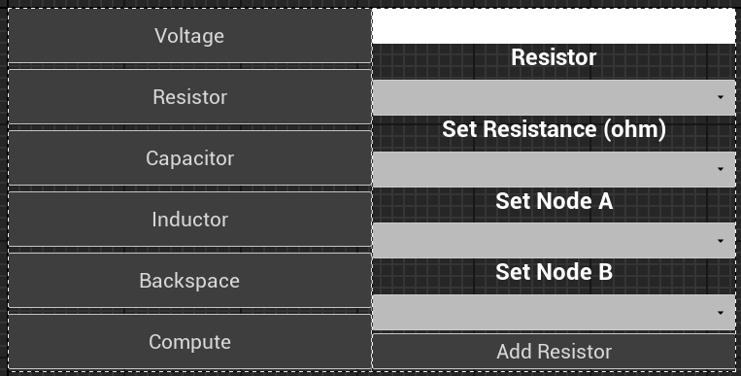
User Interface

Slide 10
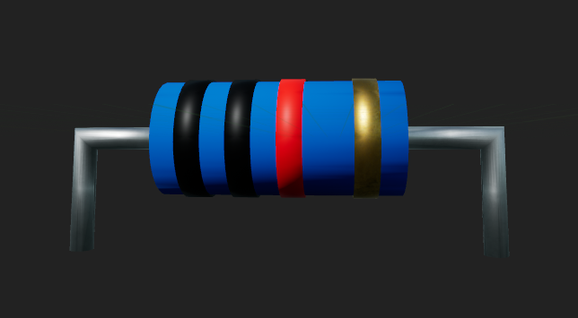
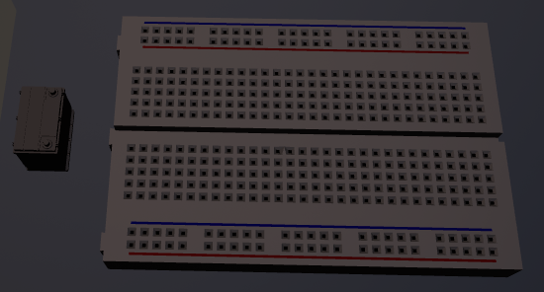
Electrical Components
DC Voltage Source​
Batteries​
Passive Electrical Components​
Resistors​
Capacitors​
Inductors​
Breadboard

Slide 11
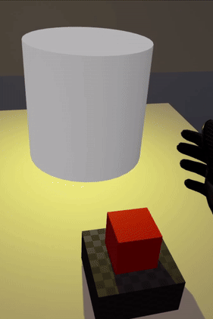
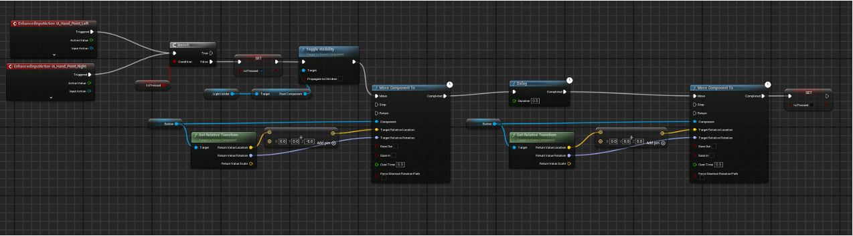
Object Interactions
Blueprint Functionality
Collision
User Movement

Slide 12
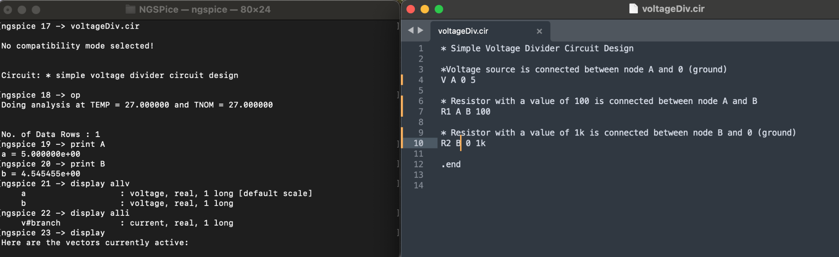
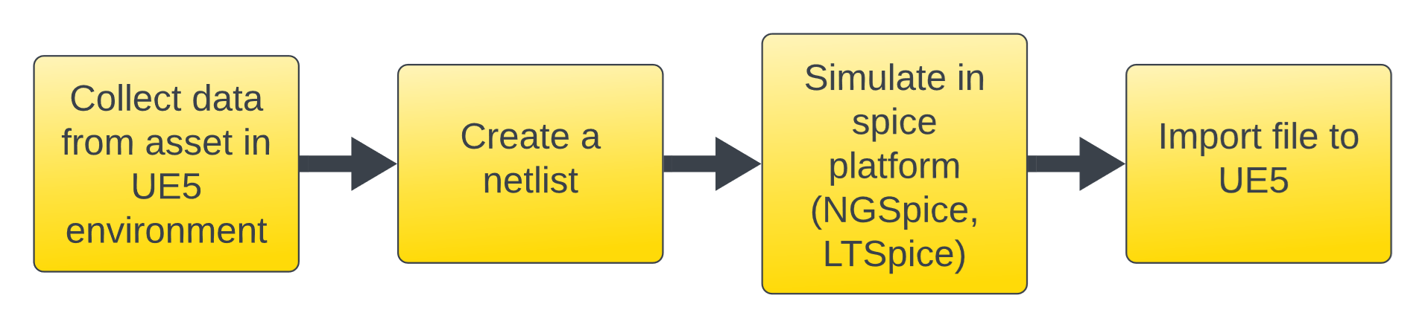

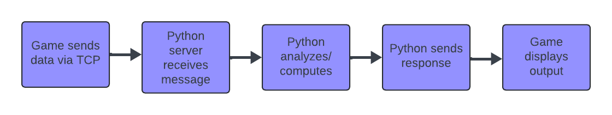
Back-End Development
Previous:
Current:
Notes:
Before:
Manually collect data from UE as csv, parse csv into netlist (consists of a list of the electronic components in a circuit and a list of the nodes they are connected to). Simulate netlist in NGSpice (open source circuit simulator) using command lines, export simulation as csv and then import it back to UE5.
Now:
We integrate TCP(communications standard for delivering data and messages through networks) into the game to communicate with the server.
•SPICE is open-source software that simulates the operating conditions of analog circuits. It is short for Simulation Program with Integrated Circuit Emphasis. Engineers use SPICE to mathematically predict the performance of electronics circuits.
•TCP Socket Plugin uses blueprint communication with TCP server coded in Python
TCP - communications standard for delivering data and messages through networks.
Ngspice – One of the known SPICE circuit simulators that numerically solves equations describing electronic circuits using Netlists and command lines.
PySpice - Free and open-source Python module which interface Python to the Ngspice circuit simulator.

Slide 13
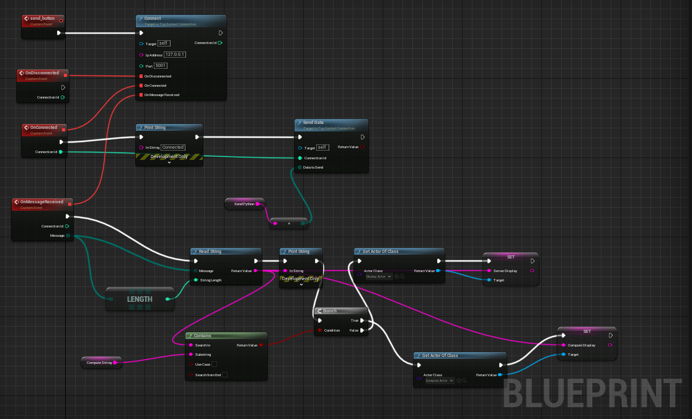
Back-End Development (cont.)
UE5 utilizing TCP Socket Plugin
Notes:
TCP Socket Plugin allows communication with a TCP server purely in blueprints. Client-only functionality.
How to use: Create a Blueprint Actor inheriting from TcpSocketConnection, drop it into level and use it.

Slide 14

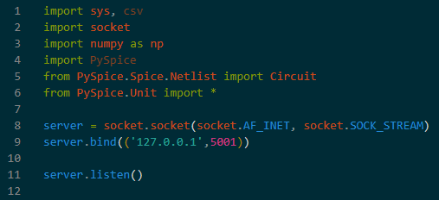


Python Server
Socket Programming in Python
Notes:
List of libraries used in Python
How to create a socket server using Python via local host
Then the server listens for a TCP connection

Slide 15
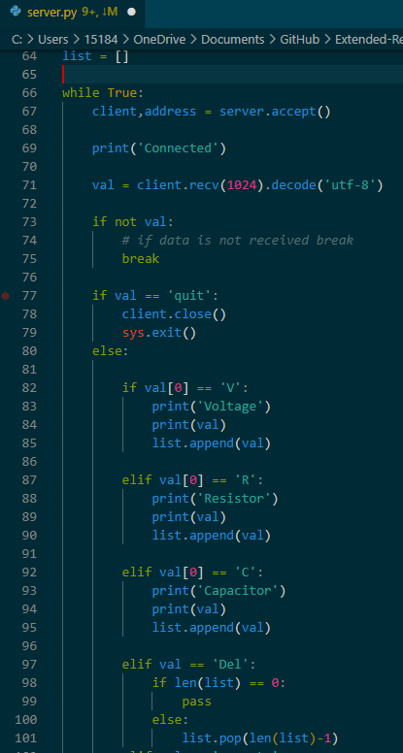
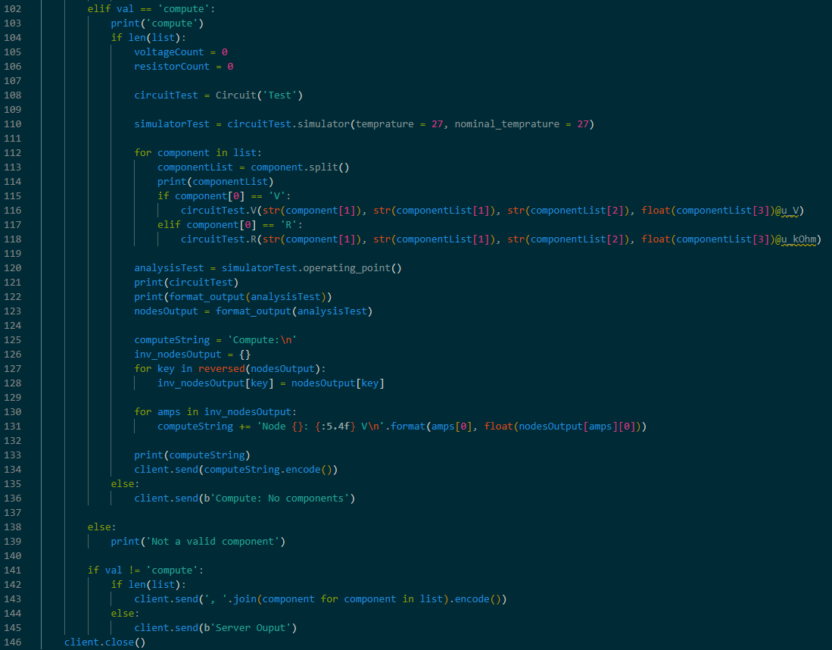
Python Server (cont.)
Notes:
On the Left:
When the game connects to the server, the server will wait for a message from the game.
Once the message is received, it is then parsed through the if and else statements which is similar to case statements in other languages such as C. (Python doesn’t have those)
Currently, we can only receive 3 different components which are: Voltage, Resistor, and Capacitor
The server is able to differentiate each one of them by checking the first letter of the string that is sent from the game.
First letter corresponds to component’s first letter. (Example: V for voltage)
Once the server knows whichever it is, it adds it to the current list of components and then returns it into the game via text block
On the right:
There’s also two more functions which are delete and compute.
Delete: Allows user to delete the most recent component off the list then the server returns the newly edited list.
Compute: Takes the current component list and calculates voltage across nodes from a circuit compiled of those components using PySpice simulation.
Which is then return to the game.

Slide 16
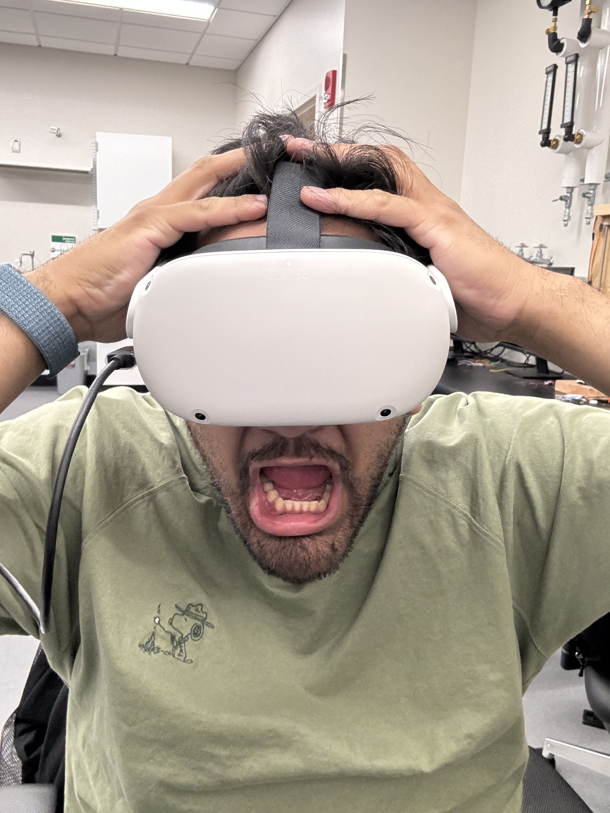
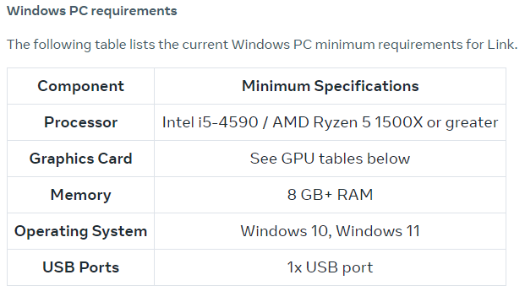
Physical Design
Hardware:
Meta Quest 2
Desktop Computer
Link Cable
Notes:
Clearly define the problem or challenge you are addressing​
Tasks for this project include developing initial requirement analysis and hardware/software requirements to build these applications.​
It will involve using some AR/VR equipment and AR/VR development suite for iPhone/android​

Slide 17
Limitations
Hardware​
GPU​
CPU​
RAM​
Physical Spatial Requirements​
Immersion​
Collision​
Limited Feedback​
Vibrations​
Pressing Controller Buttons
Software​
C++ in Unreal heavily relies on Unreal-specific code

Slide 18
Recommendations for Future Work
Front-End & Visual Updates
Expand Device Models for Active, Analog, & Digital Elements
Standardize 3D Model Electrical Components​
Arduino Support from Plugins​
Consider Porting the Project From UE5 to Unity​
Notes:
Switch engine from UE5 to Unity​
Developed the backend python server​
There are plugins for Unity that allows tcp socket connections​
Larger Dev community​
More Documentation​
better supports VR and AR​
Optimized for running on its own​
html5 support​

Slide 19
Conclusions
Our VR learning experience represents a significant advancement in educational technology,
providing students with a dynamic and immersive platform for mastering electrical engineering principles. As VR technology continues to evolve, we anticipate further enhancements and refinements that will further enrich the learning experiences of future generations of electrical engineers.
Notes:
Briefly summarize your main findings and their implications​
Reinforce why your research is significant

Slide 20
Individual Contributions
Joren Cruz
Archivist, Scheduler
Diego Tapia
Point of Contact
Daniel Wang
Editor, Treasurer
SPICE Integration
Socket programming
Documentations
Component Design
Object Interaction
Display Logic
GitHub Repository
Project Development in UE5
Menu Widget Design

Slide 21
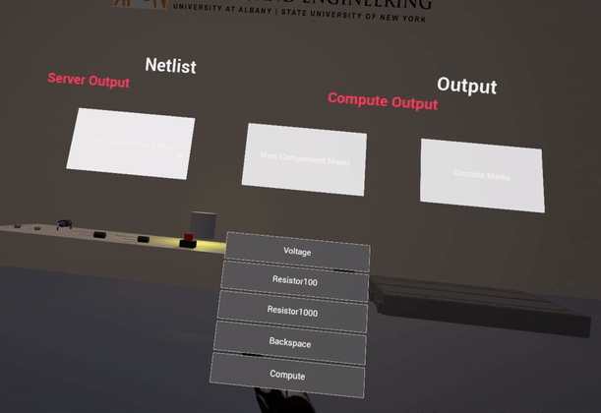
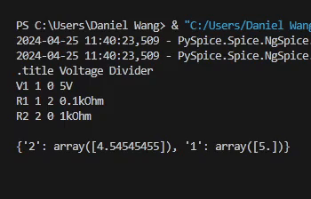
System Demonstration

Slide 22
Questions?
Notes:
It’s considered good practice to put your best​
visualization(s) as your final slide. This way you have an​
excellent visual(s) up on the screen during the Q&A portion.

